Slide 1
GCBASIC
PIC18FxxQ24
Part 13 - Using a SPI GLCD display solutions

Slide 2
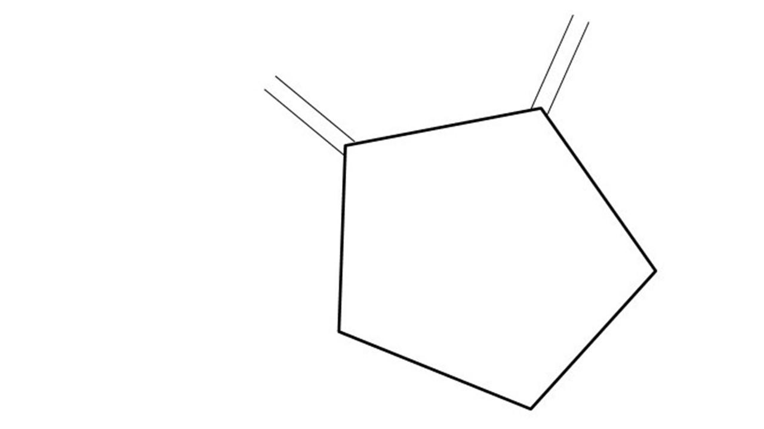
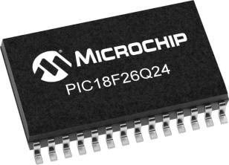
GCBASIC
PIC18FxxQ24
Part 13 - Using a SPI GLCD display solutions

Slide 3
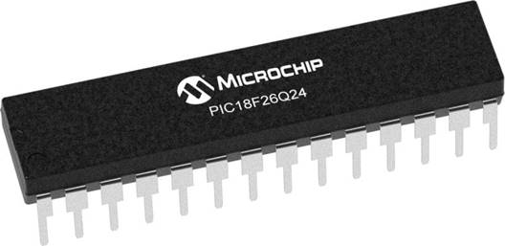
GCBASIC
Like and subscribe!

Slide 4
PIC18FxxQ24
PIC18-Q24 is a high performance PIC18
Digital and Analog peripherals
10-bit ADC
Multiple communication interfaces
Serial, I2C and SPI
PWM – CCP/PWM and 16Bit
Configurable Logic Cells
Multi voltage domains
The PIC18xxQ24 offers 28, 40 and 48-pin products in small footprint packages to support customers in a wide variety of applications.

Slide 5
Videos...
Install the hardware and make the board work – three LED programs
Make four LEDs flash in a sequence
Set the LEDs to represent the value of ADC
Sequence the LEDs with a delay using the value of ADC
Using an input to set the state of the LEDs
Using the reset switch
Using the switch, ADC – make the LEDs flash in a sequence with reverse
Using the serial to display values
Using the timer0 overflow, 8bit timer, 16bit timer to flash the LEDs
Using EEProm – showing values on the serial terminal, and more constants insights
Using I2C with serial to discover I2C devices
Using I2C GCLD display solutions
Using a SPI GLCD display solutions
Using PWM, 6 ways, to dim the LEDS
Using an external interrupt to control an LED
Using storage within the chip – Progmem, SAF memory, EEPROM and DATA blocks
Using CLC
The GCBASIC tool chain
Assembly , alternatives assemblers and MPLAB-X
Summary

Slide 6
GCBASIC Compiler
GCBASIC Compiler
GCBASIC is an Open Source compiler for PIC and AVR microcontrollers
GCBASIC now supports the 18FxxQ24 chip family

Slide 7
Prerequisites
Assumes you have
Installed the GCBASIC software
Installed your programmer software
Test that you have the 18FxxQ24 attached
You have the 4 LEDs operating
You have a POT connected
You have SWITCHes connected
You have a USB/TTL converter
GLCD SPI device

Slide 8
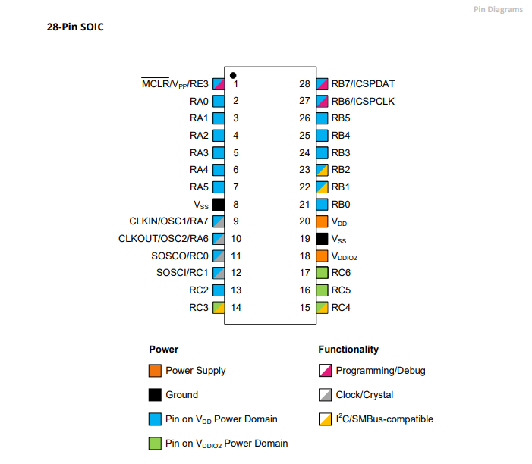
Power Domain – VDDIO2

Slide 9
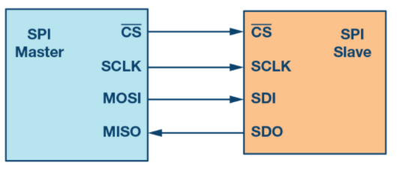
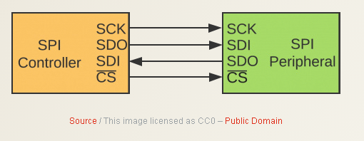
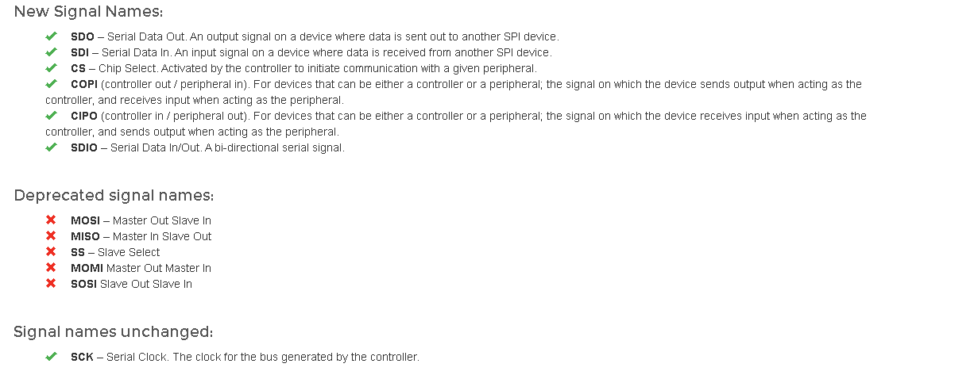
SPI
Serial Peripheral Interface (SPI) is an interface bus commonly used to send data between microcontrollers and small peripherals such as GLCD, shift registers, sensors, and SD cards.
It uses separate clock and data lines, along with a select line to choose the device you wish to control.

Slide 10
Hardware
Hardware
-------------------PORTA----------------
Bit#: -7---6---5---4---3---2---1---0---
IO: ----------------SW----------ADC--
----------------------------------------
-------------------PORTB----------------
Bit#: -7---6---5---4---3---2---1---0---
IO: ----------------LED-LED-LED-LED--
----------------------------------------
------------------PORTC-----------------
Bit#: -X---6---5---4---3---2---1---0---
IO: -^--TX------SDO-SCK-RST--CS--DC--
-----VDDIO2-----------------------------
You must apply correct Voltage
------------------PORTE-----------------
Bit#: -----------------3---------------
IO: ----------------SW---------------
Prototype Board
Power 5v0
Programmer
LEDs & resistors
Switches & resistors
SPI device and circuit

Slide 11
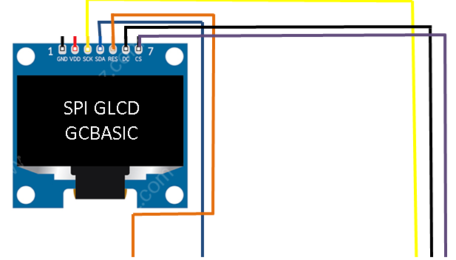
Setup - Connections

Slide 12
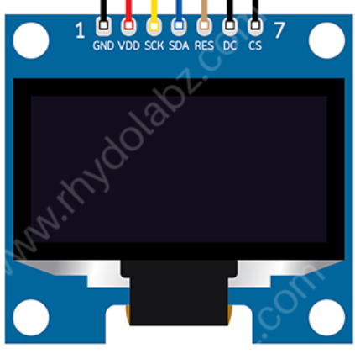
Setup - Program
SPI GLCD
GCBASIC
DATA
This is a PPS chip, so, needs to make the PPS match these assignments
#DEFINE GLCD_DO portC.4
#DEFINE GLCD_SCK portC.3
'Pin mappings for GCLD
#DEFINE GLCD_DC portC.0
#DEFINE GLCD_CS portC.1
#DEFINE GLCD_RESET portC.2

Slide 13
Setup – when things do not work ..
Things do not always work
The more connections the more trouble
Things we know
The GLCD demonstration works
Therefore is not likely to be the libraries but … work through the checklist first
Checklist
Check your connections, twice
Write a program to pulse a signal on each line, each line on at a time
Always use the software SPI first to prove connectivity
Then, use PPS/hardware SPI is #2 works

Slide 15
Lab
Review setup and operation of a SPI GLCD
Software SPI – bit banging
Harware SPI – with PPS ( of course)
Conditional compilation

Slide 16
Videos...
Install the hardware and make the board work – three LED programs
Make four LEDs flash in a sequence
Set the LEDs to represent the value of ADC
Sequence the LEDs with a delay using the value of ADC
Using an input to set the state of the LEDs
Using the reset switch
Using the switch, ADC – make the LEDs flash in a sequence with reverse
Using the serial to display values
Using the timer0 overflow, 8bit timer, 16bit timer to flash the LEDs
Using EEProm – showing values on the serial terminal, and more constants insights
Using I2C with serial to discover I2C devices
Using I2C GCLD display solutions
Using a SPI GLCD display solutions
Using PWM, 6 ways, to dim the LEDS
Using an external interrupt to control an LED
Using storage within the chip – Progmem, SAF memory, EEPROM and DATA blocks
Using CLC
The GCBASIC tool chain
Assembly , alternatives assemblers and MPLAB-X
Summary

Slide 17
GCBASIC
PIC18FxxQ24
Part 13 - Using a SPI GLCD display solutions

